Slide 1

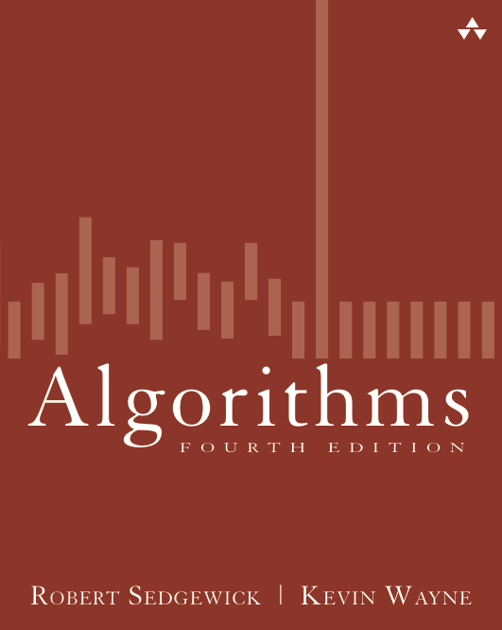
2.1 H-sorting Demo
Algorithms
Robert Sedgewick | Kevin Wayne
http://algs4.cs.princeton.edu

Slide 2









h-sorting demo
An array is h-sorted if a[i-h] <= a[i] for each i.
7-sorted

Slide 3
h-sorting demo
An array is h-sorted if a[i-h] <= a[i] for each i.
7-sorted

Slide 4
h-sorting demo
An array is h-sorted if a[i-h] <= a[i] for each i.
7-sorted

Slide 5
h-sorting demo
In iteration i, swap a[i] with each larger entry h positions to its left.

Slide 6
h-sorting demo
In iteration i, swap a[i] with each larger entry h positions to its left.
j
i
not yet processed

Slide 7
h-sorting demo
In iteration i, swap a[i] with each larger entry h positions to its left.
j
i
not yet processed

Slide 8
h-sorting demo
In iteration i, swap a[i] with each larger entry h positions to its left.
i
3-sorted
not yet processed

Slide 9
h-sorting demo
In iteration i, swap a[i] with each larger entry h positions to its left.
j
i
not yet processed

Slide 10
h-sorting demo
In iteration i, swap a[i] with each larger entry h positions to its left.
j
i
not yet processed

Slide 11
h-sorting demo
In iteration i, swap a[i] with each larger entry h positions to its left.
i
3-sorted
not yet processed

Slide 12
h-sorting demo
In iteration i, swap a[i] with each larger entry h positions to its left.
j
i
not yet processed

Slide 13
h-sorting demo
In iteration i, swap a[i] with each larger entry h positions to its left.
i
3-sorted
not yet processed

Slide 14
h-sorting demo
In iteration i, swap a[i] with each larger entry h positions to its left.
j
i
not yet processed

Slide 15
h-sorting demo
In iteration i, swap a[i] with each larger entry h positions to its left.
j
i
not yet processed

Slide 16
h-sorting demo
In iteration i, swap a[i] with each larger entry h positions to its left.
j
i
not yet processed

Slide 17
h-sorting demo
In iteration i, swap a[i] with each larger entry h positions to its left.
i
3-sorted
not yet processed

Slide 18
h-sorting demo
In iteration i, swap a[i] with each larger entry h positions to its left.
j
i
not yet processed

Slide 19
h-sorting demo
In iteration i, swap a[i] with each larger entry h positions to its left.
i
3-sorted
not yet processed

Slide 20
h-sorting demo
In iteration i, swap a[i] with each larger entry h positions to its left.
j
i

Slide 21
h-sorting demo
In iteration i, swap a[i] with each larger entry h positions to its left.
j
i

Slide 22
h-sorting demo
An array is h-sorted if a[i-h] <= a[i] for each i.
3-sorted

Slide 23
h-sorting demo
An array is h-sorted if a[i-h] <= a[i] for each i.
3-sorted

Slide 24
h-sorting demo
An array is h-sorted if a[i-h] <= a[i] for each i.
3-sorted

Slide 25
h-sorting demo
An array is h-sorted if a[i-h] <= a[i] for each i.
3-sorted

Slide 26
h-sorting demo
An array is h-sorted if a[i-h] <= a[i] for each i.
still 7-sorted (!)

Slide 27
h-sorting demo
An array is h-sorted if a[i-h] <= a[i] for each i.
still 7-sorted (!)

Slide 28
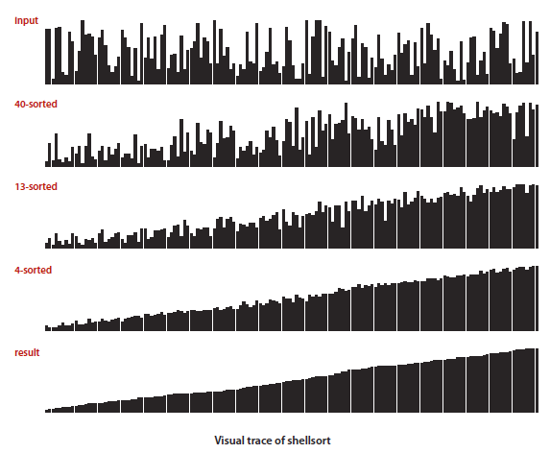
Visually

Slide 29
code
int A[N]={0};
fillRandom(A,N);
print(A);
// Shelll sort
// Sort a[] into increasing order.
int h = 1;
while (h < N/3) h = 3*h + 1; // 1, 4, 13, 40, 121, 364, 1093, ...
while (h >= 1)
{ // h-sort the array.
for (int i = h; i < N; i++)
{ // Insert a[i] among a[i-h], a[i-2*h], a[i-3*h]... .
for (int j = i; j >= h && small(A[j], A[j-h]); j -= h)
swap(A, j, j-h);
}
print(A);
h = h/3;
}

